Slide 1
Decide and Provide Guidance and Transport Policy
Mike O’Dowd-Jones - Head of Transportation mike.odowdjones@somerset.gov.uk

Slide 2
Overview
The drive for change – New Unitary – Leadership
Culture change and buy-in
Policy approach – policy at speed
Guiding principles
Consultation – Creating Places for People
Technical guidance
Emerging challenges

Slide 3


The drive for change
Somerset new unitary authority from March 23
Change in administration
Clear manifesto commitments on sustainability and climate action
Time of considerable change - leadership – new executive & CEO, new directors, rapid change
Influence of place priorities from former districts
Need for a new local plan and local transport plan (& other plans – local nature strategy, energy, climate etc)
Alignment (at the time) with Government policy direction
Personal desire for change

Slide 4
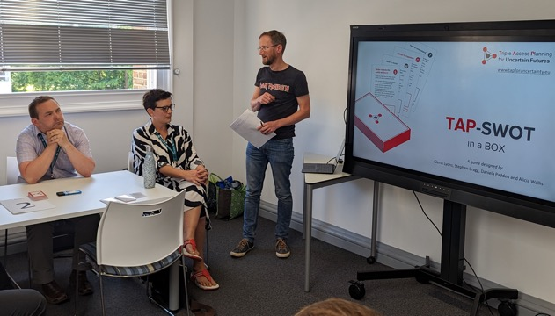
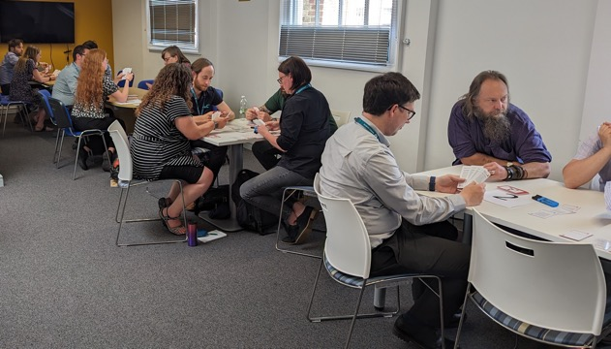
Culture change and buy-in
Building on pre-unitary ‘enabling growth’ programme: End-end review of the planning process – connections and relationships.
Interview sessions with a cross section of staff from transport and planning – establish current state – identify concerns and advocates
Workshop 1: Introduce concepts and establish level of buy-in: Triple Access Planning game.
Workshop 2: Discuss outcome of interviews and how to apply concepts on a live major application & move to a stronger vision-led approach. Developed outline vision.

Slide 5

Principles
Policy at speed
Endorse and adopt a set of guiding principles - ‘Policy Principles’
Simple statements to change/ set direction and context for future decisions
Scrutiny & Executive approval subject to consultation
Influence actions immediately
Recognise that complex evidence based / legal processes will follow to establish the policies in detail.

Slide 6
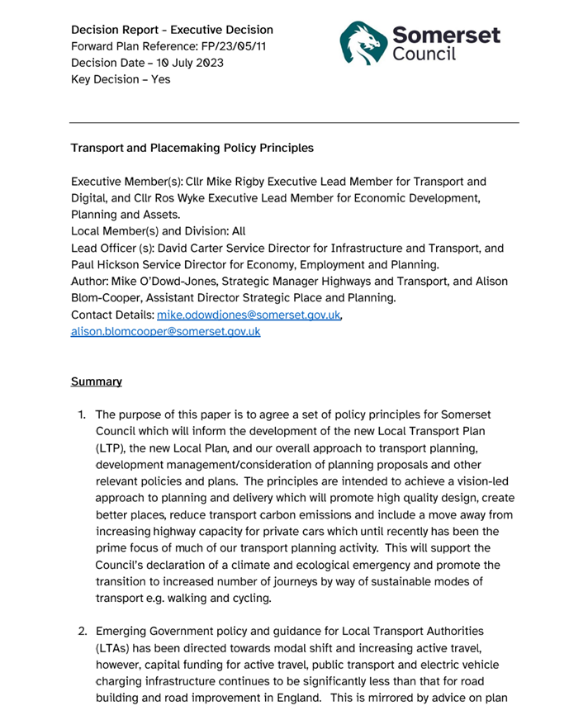
Policy at speed
Transport and Placemaking Policy Principles – Executive Board 10 July 2023 to inform:
  Development of the Local Transport Plan & Local Plan
  Overall approach to transport planning & development management
  Consideration of planning proposals
  & other relevant policies and plans.

Slide 7

Transport and Placemaking Policy Principles
Achieve a vision-led approach to planning and delivery
Promote high-quality design
Create better places
The start of a conversation
Reduce transport carbon emissions
Move away from increasing capacity for private cars which until recently has been the prime focus of much of our transport planning activity
Support the declaration of a climate and ecological emergency

Slide 8
Transport and Placemaking Policy Principles
Good street/ place design:
Community cohesion
Healthy lifestyles
Local facilities
Attractive environment - safer and easier for people to move around and connect with each other
Rural issues and environments need different solutions to urban places
Opportunity to agree EV fleet and infrastructure policy & set direction on part-night-lighting policy!

Slide 9




















Guiding Principles (1)
  Reducing carbon emissions will be the key priority for the transport and development plans including adoption of a transport decarbonisation pathway.
CO₂
  We will adopt a holistic approach to policy and strategy development, working beyond just transport. We will ensure that all our policies are rural-proofed and will continue to build relationships with public health, education services, adults and children’s social care and others within the organisation to deliver co-benefits.
  We will adopt a vision-led or 'decide and provide' approach to new development whereby a strong vision for great places to live with a reduced need to travel is agreed. This will involve co-locating housing and other facilities to create neighbourhoods where the natural first choice is to walk or cycle to access work, education, learning and healthcare etc.

Slide 10






Guiding Principles (2)
  We will endorse the vision led approach to street and highway design as part of wider high quality placemaking; and agree the vision and principles as set out in Appendix A for consultation with key stakeholders.
  Subject to detailed analysis, priority policy interventions will be related to reducing the need to travel and promoting sustainable travel (active travel for shorter distances, e-bikes and micromobility for slightly longer distances, shared transport, bus, demand responsive transport, and rail for longer distances; and policy interventions such as parking management that aim to reduce demand for travel by private car).
  We will expect developers to provide high quality active travel and public transport networks within and accessing new development areas, to ensure new development does not create significant additional congestion, rather than creating additional highway capacity for private car traffic. We will expect developers to implement high-quality sustainable travel plans which include a wide range of measures and incentives to enable active travel.

Slide 11




Guiding Principles (3)
  Increasing highway capacity will only be considered as a last resort and in exceptional circumstances. We will continue to complete highway capacity improvements that are already in the pipeline as funded schemes but it is likely that we will not be seeking Government funding for improvements that increase capacity for private car travel beyond the current pipeline.
  We will build on the successful community -led approach to constructing rural multi-user paths between settlements and will co-develop a proposed network for community-based delivery. We will also consider how to create an improved environment for pedestrian movement in more semi-urban, rural locations where the environment can be dominated by high-speed traffic.
  We will aim to secure a devolved Government funding package to implement an ambitious sustainable transport programme, building on our current success with Bus Service Improvement Plan funding and Active Travel funding.

Slide 12


Guiding Principles (4)
  We will oversee delivery of a comprehensive charging network for electric vehicles and will appoint a private sector delivery partner to ensure that public funding is only used where necessary to address market failure in a similar way to that adopted for Broadband rollout. EV recommendations are set out in Appendix B.
  The Council's own vehicles up to and including 3.1 tonnes GVW and those of our contractors will be electric vehicles as soon as this can be realistically, and cost effectively achieved; and we will consider alternative fuels for larger vehicles at the earliest opportunity in line with the evolution of emerging technology. [as amended at Executive 10th July]
/H?
  We will work with bus operators to agree the most appropriate alternative fuels pathway for public transport operations and support them in implementing this.
/H?

Slide 13




Guiding Principles (5)
  We will develop a new policy seeking greater consistency in highway lighting, creating a default preference for part-night lighting, dimming and user activated lighting.
  We will examine the implications of incorporating explicit requirements for carbon reduction and reduced travel across all the Council's services, including carbon reduction targets within our contracts with suppliers, with a view to implementing changes to our procedures at the earliest opportunity.
CO₂

Slide 14

Placemaking & Movement Principles (1)
  1
  Reduce need to travel via private car (internal trips) by ensuring key facilities and services, existing and proposed, are within a 20-minute walking or wheeling time. Streets should link to existing roads and local services, ensure permeability, connectivity and not turn their backs on neighbours.
  2
  In towns and more urban areas reduce parking provision in combination with hard and soft travel plan measures and include the provision of car/bike clubs, EV bikes/scooters, EV charging and public transport provision. Incorporate a mobility hub approach with mobility and non-mobility components as suitable for the site. The vision in these areas is for low car ownership and ambitious modal shift enabled by an increase in multimodal travel measures.
P
  3
  Design parking to be unobtrusive in the public realm, avoiding dominance in the streetscene. Allow for the future phasing out of parking to reduce carbon emissions as ownership levels reduce. Prioritise car ports over garages. Secure cycle parking / infrastructure is to be provided with well-designed storage facilities either on street or within the property street frontage. Public cycle repair facilities should be incorporated into the scheme.
P
P

Slide 15








Placemaking & Movement Principles (2)
  4
  Design an attractive and high-quality environment where streets incorporate trees in the highway and green spaces, avoiding large expanses of asphalt. Wherever possible streets should make positive use of existing natural features. Highway trees should be provided in tree pits rather than planters. The design should build in opportunities for biodiversity net gain, green infrastructure, surface water management (permeable surfaces, swales, SUDS) and opportunities to contribute to phosphate mitigation.
  5
  Design using natural traffic calming to achieve speeds less than 20mph. Buildings and footways should be located to define junctions. Junction and vehicle movement geometry, sightlines and tracking should be tightened to reduce vehicle speeds with priority given to pedestrians and cyclists.
20
  6
  Careful consideration should be given to how children and parents are to access schools without reliance upon private cars, instead encouraging walking, cycling and public bus use. The design approach to school parking will reflect the desire to maximise active travel movements to school.
  7
  Material palettes are to be simple, take the local context into account (not just black top). Material attractiveness, reducing carbon emissions as well as durability and ease of maintenance are to be considered.
CO₂

Slide 16










Placemaking & Movement Principles (3)
  8
  Design should seek to minimise street clutter and keep footways and cycleways clear of infrastructure. Lighting, signage and public EV charging should, where possible, be fixed onto a structure.
  9
  Consider services and lighting at an early design stage to avoid impact on placemaking features like street trees and the quality of the movement network. Consider whether lighting is required (dark skies). Undefined strips of land should be eliminated at the design stage by fully allocating land to private ownership, highway adoption or stewardship with clear definition of public and private land.
  Consideration should be given to incorporating waste storage facilities to ensure sufficient storage capacity, convenient access and design solutions that complement the wider development.
  10
  Within rural areas, the importance of safe connectivity within and between communities and facilities/services will be recognised whilst taking into account factors including landscape, character, appearance and ecology.
  11
  Ensure early engagement with and input from people with responsibility for approvals throughout the whole planning and delivery process.
  12

Slide 17
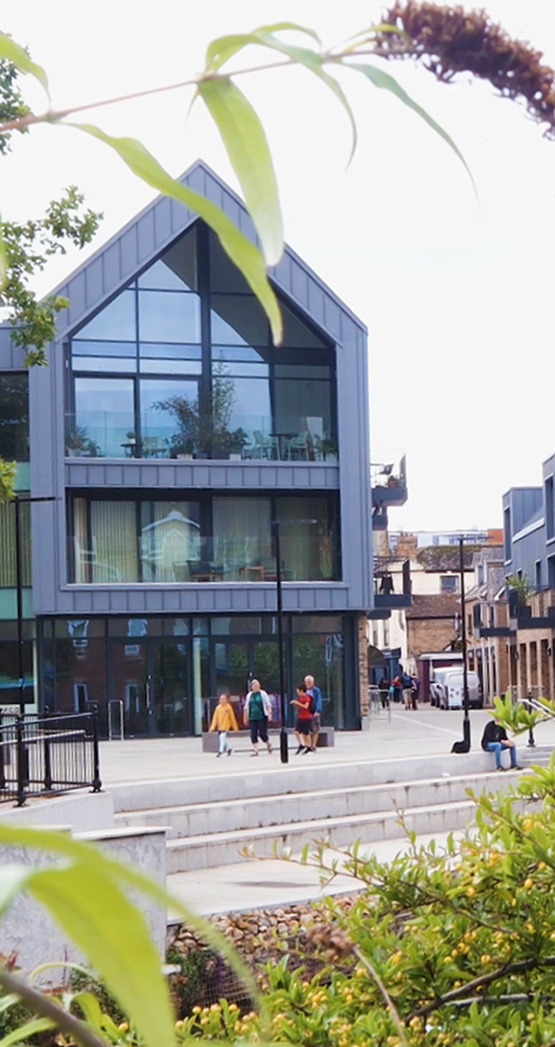
Consultation
  ‘Creating Places for People’
  https://somersetcouncil.citizenspace.com/planning/creating-places-for-people/
  September – October 2023
  Outline new guiding principles
  Stakeholder engagement
  View on priorities
  Challenges to implementation
  Anything missing?

Slide 18
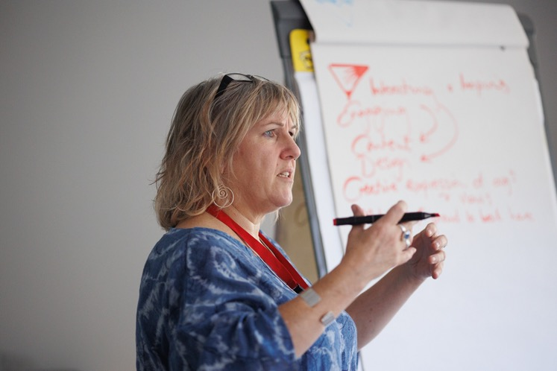
Consultation
  ‘Creating Places for People’
  883 responses currently being analysed.
      50% of responses from over 65’s.
      4% of responses from under 35’s
  Most important issue:
      Access to local facilities such as shops
  Least important issues:
      Secure bike parking; and
      ‘I can work with and support my local community’

Slide 19
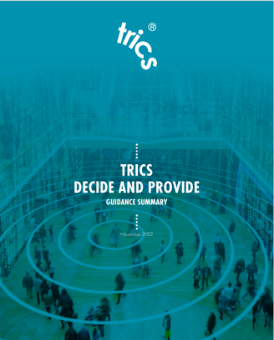
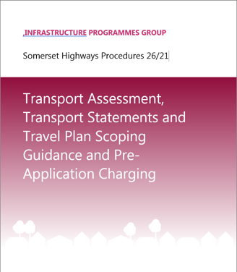
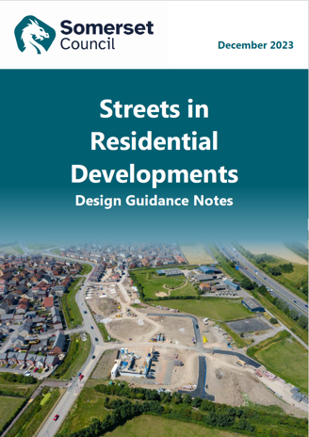
Technical Guidance
Updated ‘Transport Assessment, Transport Statements and Travel Plan Scoping Guidance and Pre-Application Charging’ to include Decide and Provide guidance
New chapter on vision led approach
Cross reference to ‘TRICS guidance note on practical implementation of the Decide and Provide Approach’, Feb 2021.
Updated ‘Streets in Residential Developments, Design Guidance Notes’, December 2023 – Now a living document
  “Developers/applicants will be required to undertake a Vision led approach for their proposals and share and agree the Vision with SC during early scoping discussions. This is particularly important for larger, more complex developments with more extended (and phased) programmes, where scenario planning will also be needed”

Slide 20


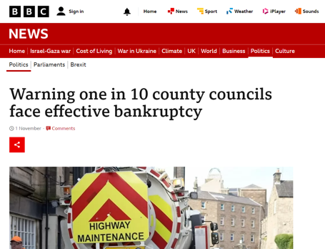
Emerging Challenges
Mike.odowdjones@somerset.gov.uk

